Slide 1

DOMAIN 2in ISC2
(incident response business continuity & disaster recovery)
BY
EZEKWE KING DAVID NNAEMEKA

Slide 2
SCOPE
INCIDENT TERMINOLOGY AND CORE CONCEPTS
GOALS AND STRUCTURE OF THE INCIDENT RESPONSE
COMPONENTS INCIDENT RESPONSE
ROLES & FUNCTION OF THE INCIDENT RESPONSE TEAM
BUSINESS CONTINUITY WORKPLACE APPLICATION AND GOALS OF BUSINESS CONTINUITY
COMPONENT AND EXECUTION OF A BUSINESS CONTINUITY PLAN
DISASTER RECOVERY STRATEGIES AND REAL WORLD APPLICATIONS

Slide 3
INCIDENT RESPONSE TERMINOLOGIES
BREACH
EVENT
EXPLOIT
INCIDENT
INTRUSION
THREAT
VULNERABILITY
ZERO DAY

Slide 4
THE GOAL OF INCIDENT RESPONSE
PROTECTION OF LIFE,HEALTH AND SAFETY OF THE BUSINESS.
RESTORE NORMAL OPERATION QUICKLY
REDUCE IMPACT ON BUSINESS PROCESSES
PREVENT RECURRENCE THROUGH LESSONS LEARNED
MAINTAIN STAKEHOLDER AND MANAGEMENT COMMUNICATION.

Slide 5
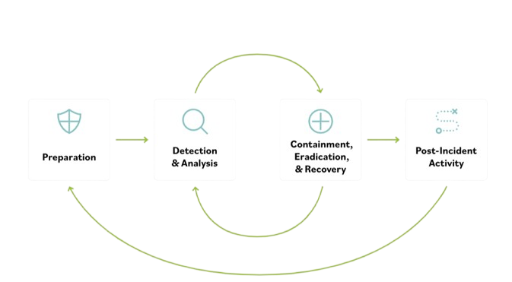
COMPONENT OF THE INCIDENT RESPONSE PLAN

Slide 6
INCIDENT RESPONSE TEAM
WHO IS THE INCIDENT RESPONSE TEAM:
● Representative(s) of senior management
● Information security professionals
● Legal representatives
● Public affairs/communications
representatives
● Engineering representatives
(system and network)

Slide 7
ROLES OF THE CIRTs/CSIRTs
Security Hardening.
Incident Remediation.
Impact Assessment.
Data Exposure Analysis.
Notes:
Supervise implementation of additional security measures to prevent recurrence.

Slide 8
BUSINESS CONTINUITY PLAN WORKPLACE APPLICATION & GOALS OF BUSINESS CONTINUITY
WORKPLACE APPLICATION:
REDBOOK
GOALS OF BUSINESS CONTINUITY
Ensure critical business operations continue during disruptions
Minimize downtime and service interruption
Protect essential assets, data, and resources
Maintain delivery of products and services to customers
Reduce financial and operational impact of disruptions
Enable fast and organized recovery after an incident
Strengthen organizational resilience and preparedness

Slide 9
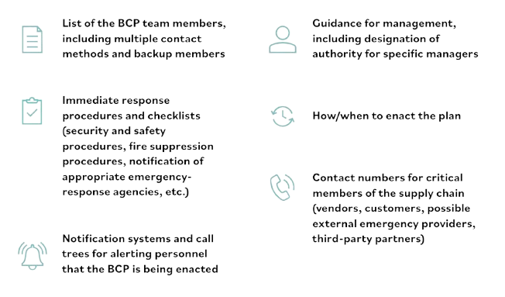
COMPONENT AND EXECUTION OF A BUSINESS CONTINUITY PLAN

Slide 10
Business
Continuity
in
Action

Slide 11
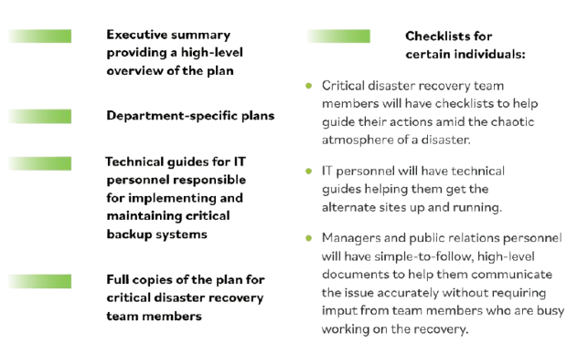
COMPONENTS OF DISASTER RECOVERY PLAN

Slide 12
CONCLUSION
Conclusion: The Resilience Triad
Respond
IR handles the immediate threat and protects life/safety.
Continue
BC ensures the mission survives the disruption.
Recover
DR brings the IT systems back to their primary state.
Preparedness is the only true defense in a Zero-Day world.

Slide 13
Q&A

